Slide 1

Gender Inclusive Features Across the Health Information System
Squiddy (he/they), 2023
Teuthida@DEFcon.social

Slide 2

Who is Squiddy?
Graduate Student @ Indiana University M.S. Health Informatics
Specializing in Health Information Security & Medical Device Security
Medical Laboratory Scientist (MLS),
Laboratory Informaticist,
Desktop Engineer,
…loud-mouthed lesbian hacker

Slide 3



We Need to Speak and Be Heard.

Slide 4

For my LGBT elders and siblings from around the world, the word “queer” is used in this presentation. Many young people in the community have chosen to reclaim this term. I mean no disrespect by using this term, and you may choose to substitute it with the term of your choosing.
For our straight and cis friends, please be aware that the term “queer” has until recently been used as a slur against LGBT individuals in the West and is still used as a slur in some parts of the globe. If someone has not chosen to identify themselves as queer, please do not refer to them as such. I ask that you use their preferred terms.
Please be respectful!

Slide 5

Gender Inclusivity
What are gender inclusive features?
At the very least, support for gender identity, preferred name,
and pronouns in order to facilitate gender-inclusive care.
Gender-inclusive care requires gender inclusive features.
Gender-inclusive care benefits everyone,
from transgender patients, to gender-nonconforming
cisgender patients, and patients who are visibly queer.

Slide 6
At Increased Risk
Transgender and gender diverse (TGD) patients have an elevated risk of overall mortality ranging from 34% to 75% in compared to cisgender patients (Jackson et al., 2023).
Transgender and GNC individuals may avoid receiving appropriate healthcare (decrease their frequency in seeking care) if their experience with providers leaves them feeling invalidated (Burgess et al., 2019).
Patients who change their sex may be more likely to experience a delay in care related to a demographic mismatch. A mismatch may be intentional for insurance purposes (Allison et al., 2021).
Marginalized populations experience an Increased risk to their patient safety, this is not a phenomenon exclusive to transgender individuals. We need to pay attention to the experience of these patients in order to improve healthcare for all.

Slide 7

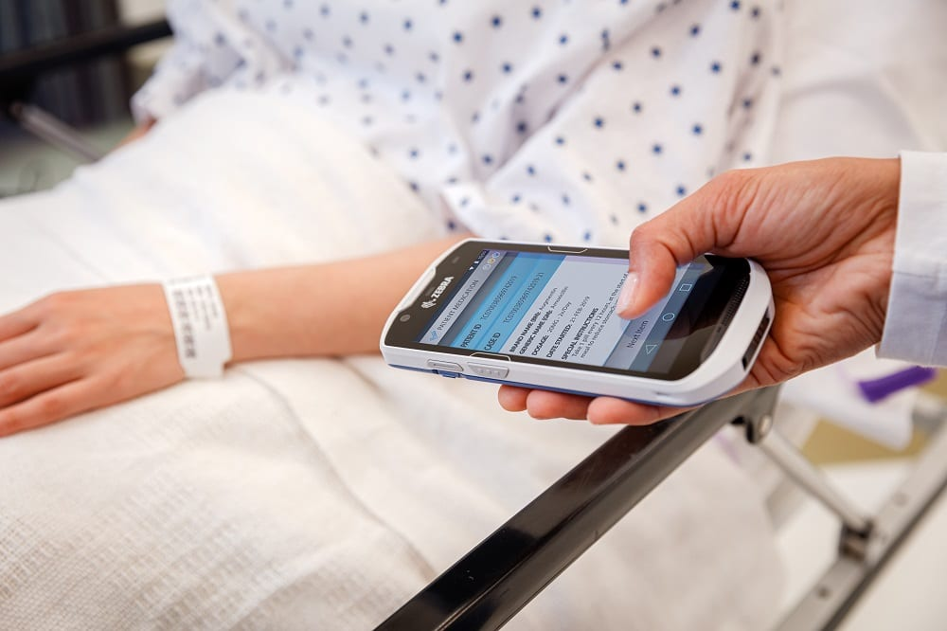

“Where does my PHI go?”

Slide 8

What is an HIS?
Health Information System (HIS): A system that manages Healthcare Data. Examples include electronic health record (EHR) systems, Laboratory Information Systems (LIS), and Radiology Information systems (RIS).
I say “across the HIS” but it is really “across multiple health information systems” which together form a web that manages patient data.

Slide 9
Patient Demographic Mismatch
A patient demographic mismatch can delay patient care, lead to information being merged to the wrong patient chart, result in incompatible blood transfusions, errors in medication administration, and erroneous diagnostic lab results.
Transgender patients, for various reasons, may seek to alter their birth sex in their medical record as it is their right to do so. This can interfere with preventative screening, and lead to misinterpretation of laboratory results.
We cannot rely solely on biological sex.
Frequency of demographic mismatch will continue to increase, even with healthcare standards and middleware designed to improve interoperability.

Slide 10

For Example… Patient Cases

Slide 11
Not an Isolated Issue
Demographic mismatches are not exclusive to transgender care, by incorporating gender-inclusive features we add an additional way to identify a patient and prevent a demographic mismatch. What is unique in the risk posed to trans patients is the frequency in which it can occur.
A demographic mismatch doesn’t just occur in the ER, there is always a possibility of human error during registration that can lead to delayed care or duplicate patient records.
A demographic mismatch can occur in all healthcare facilities that utilize electronic solutions to manage patient data, it isn’t specific to major hospitals, or certain hospital settings.

Slide 12

We Shouldn’t Have to Choose
Transgender patients should not have to choose between the possibility of being misgendered and receiving appropriate care, or not receiving care at all. Providers should rely on more than just sex and gender when determining appropriate care for any patient.

Slide 13
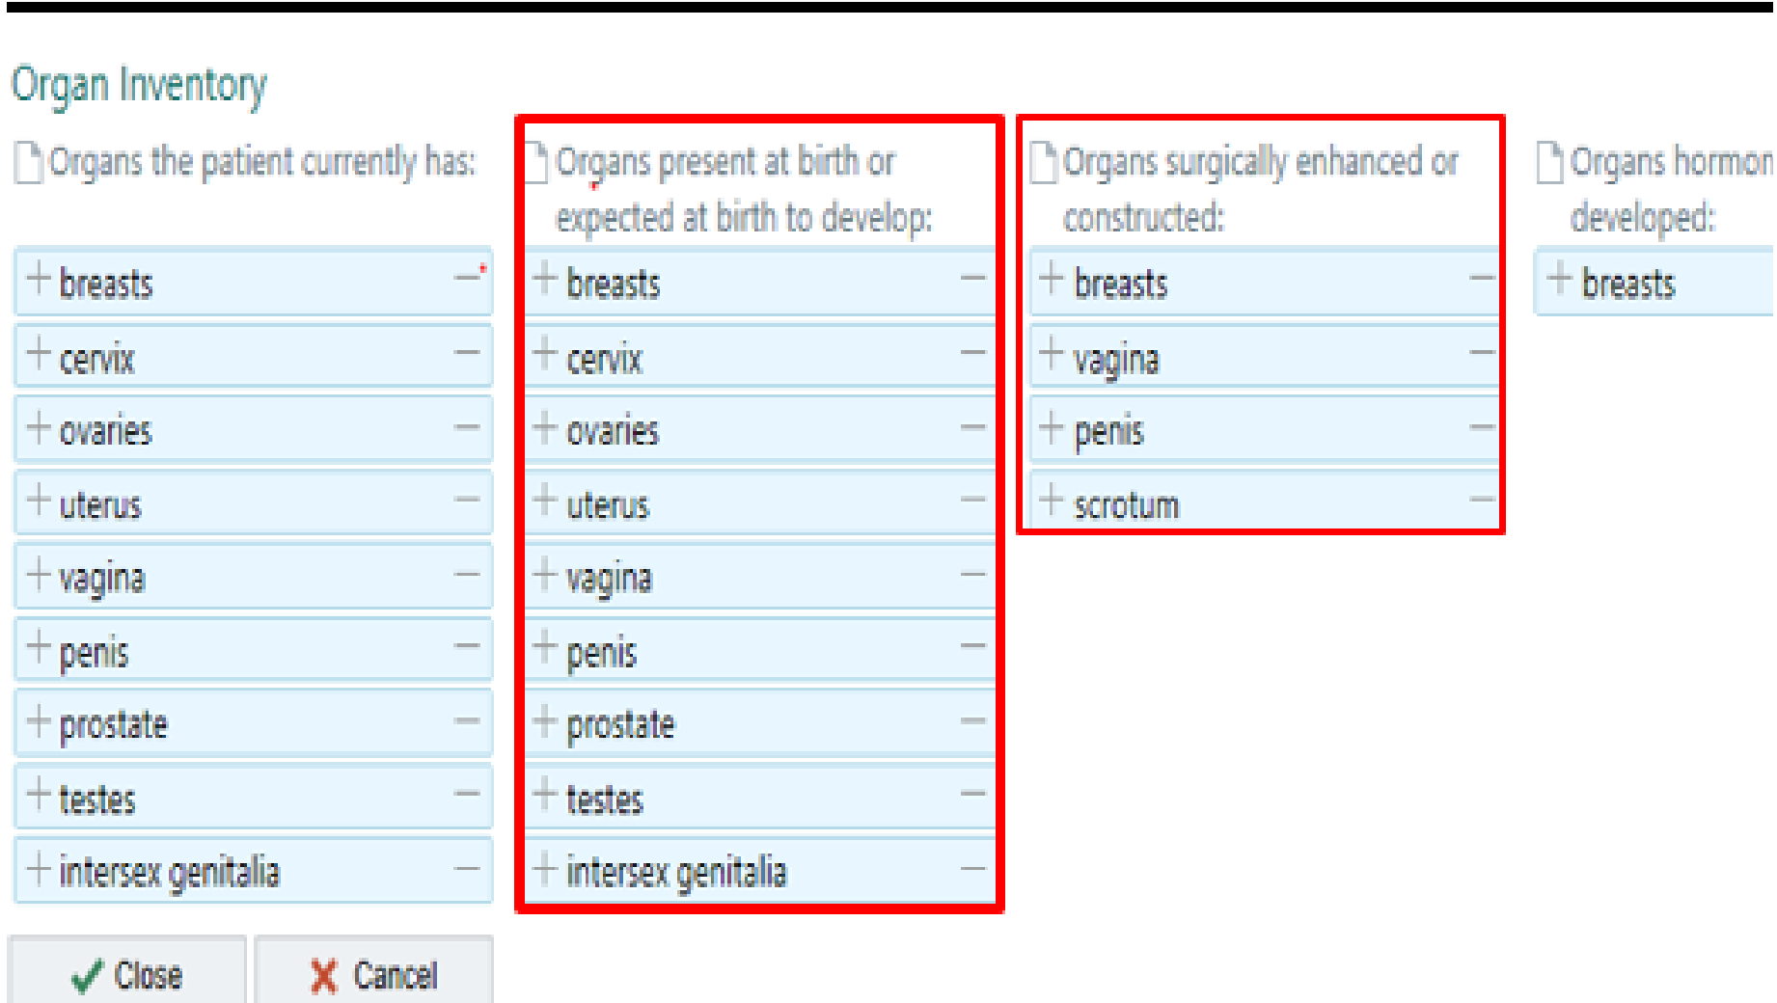
What Can We Do?
We can push for more gender inclusive features, and push for them to be incorporated every step of the way, from the patient chart to the laboratory!
Anatomical (organ) Inventories are ideal solutions and can also include surgeries that a patient has had performed. This would also improve care for intersex patients. Inventory data can link to corresponding ICD-10 codes to assist with billing purposes.
Incorporating gender inclusive features in the laboratory would lead to test result values being flagged appropriately for transgender patients, and expected result ranges that are tailored to suit an individual undergoing HRT.
Additionally, if a patient whose sex has changed is also categorized as transgender, the incorporation of gender identity could potentially prevent results from failing to cross to a patient’s chart.

Slide 14
Thank you!

Slide 15

References
Allison, M. K., Marshall, S. A., Stewart, G., Joiner, M., Nash, C., Stewart, M. K.(2021). Experiences of transgender and gender nonbinary patients in the emergency department and recommendations for healthcare policy, education, and practice. The journal of Emergency Medicine, 61(4),396-405. doi: 10.1016/j.jemermed.2021.04.013
Burgess, C., Kauth M. R., Klemt, C., Shanawani, H., & Shipherd, J. C.(2019). Evolving sex and gender in electronic health records. Federal Practitioner, 36(6, 271-277. Retrieved from https://www.ncbi.nlm.nih.gov/pmc/articles/PMC6590954/
Grasso, C., Goldhammer, H., Thompson, J., Keuroghlian, A. S.(2021). Optimizing gender-affirming medical care through anatomical inventories, clinical decision support, and population health management in electronic health record systems. Journal of the American Medical Informatics Association, 28(11), 2531-2535. doi: 10.1093/jamia/ocab080.
Jackson, S. S., Brown, J., Pfeiffer, R. M.(2023). Analysis of mortality among transgender and gender diverse adults in England. JAMA Network Open, 6(1),e2253687. doi:10.1001/jamanetworkopen.2022.53687
Portillo, R.(2021). How to use and implement the transgender toolkit: an educational program for providers. Retrieved from https://health.ucdavis.edu/nursing/news/Events/PDF/June2021/Reyna-Portillo-AS21.pdf

